Slide 1
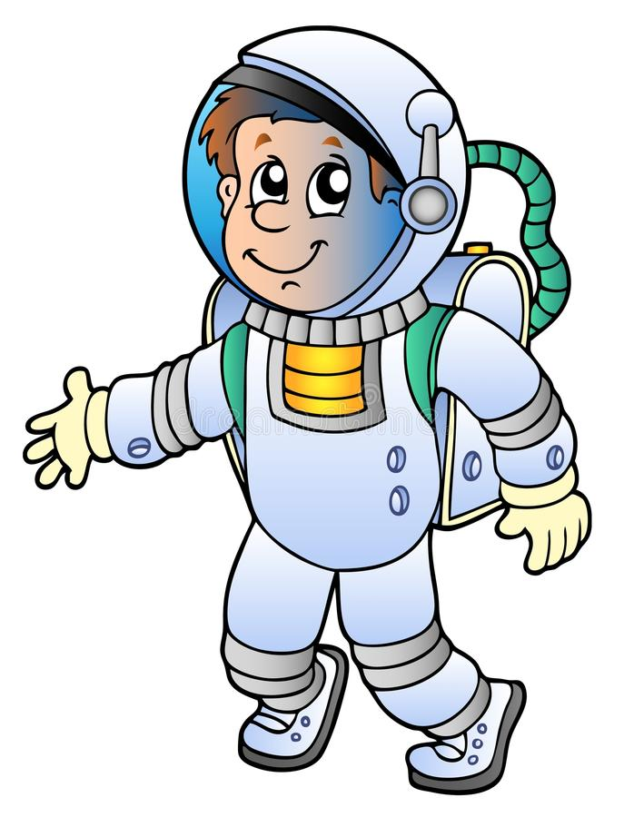
«From the school path to the stars»

Slide 2
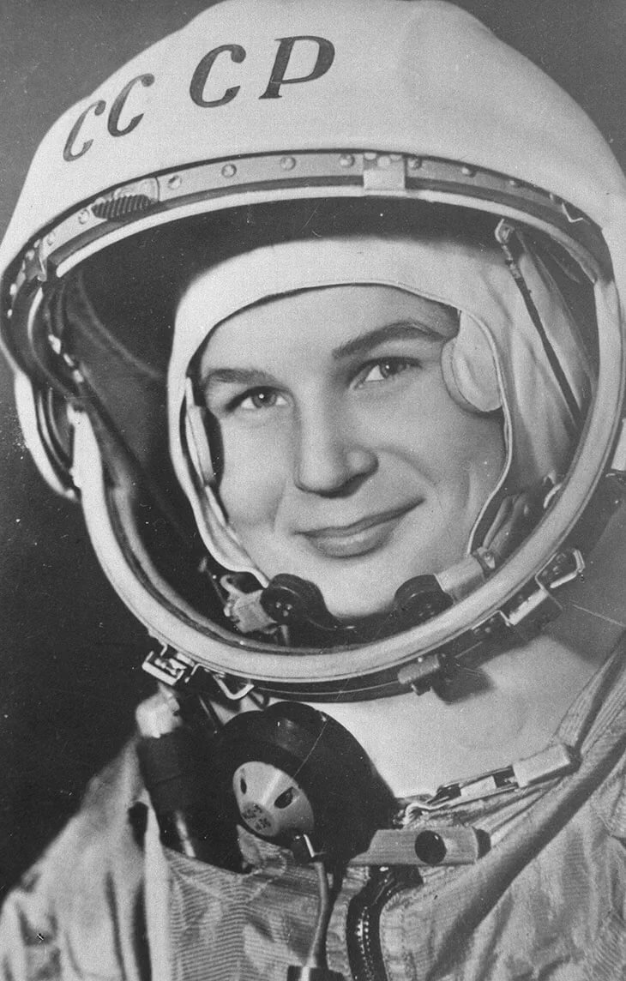
The aim of this paper is:
to identify memorable places associated with the life of V.V.Tereshkova and include them into the tourist booklet.

Slide 3
The objectives of the work are:
1. To study different sources of information about V.V. Tereshkova;
2. To select memorable places and describe them;
3. To make up a tourist route and a travel booklet.

Slide 4
Memorable places associated with V. V. Tereshkova

Slide 5
Museum of V. V. Tereshkova – «Cosmos» ( Nikulskoye)

Slide 6
Secondary school № 32 named after V.V. Tereshkova

Slide 7
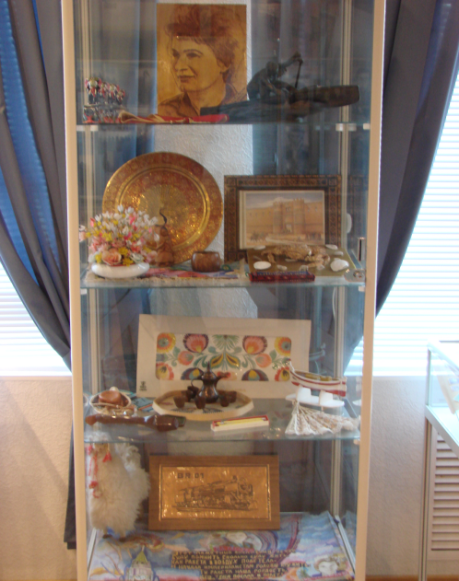
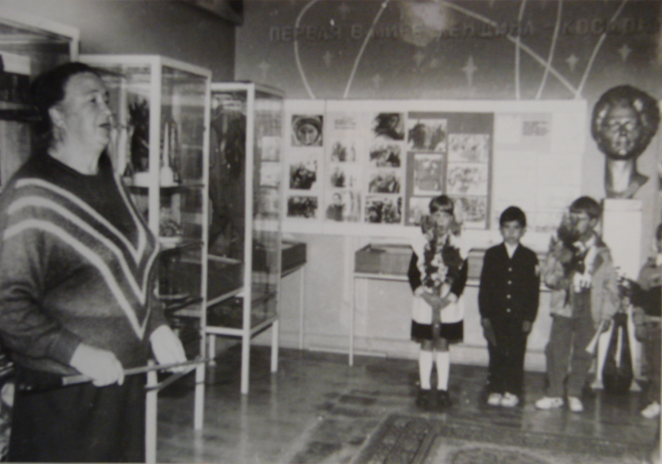
The museum of school №32

Slide 8
The textile factory «Krasny Perekop»

Slide 9
The textile factory «Krasny Perekop»

Slide 10
The Cultural and Educational Centre named after V. V. Tereshkova

Slide 11
Conclusion
1. We have studied the scientific material, marked memorable places and described them;
2. We have made a tourist route and a travel booklet;
Thanks to the tourist booklet, guests of our city will be able to learn and visit memorable places associated with the life of V.V. Tereshkova

Slide 12
References
Музей«Космос» в Никульском: экспозиции, адрес, телефоны, время работы, сайт музея [электронный ресурс] // URL: // https://tonkosti.ru
Музей «Космос» им. В.В. Терешковой [электронный ресурс] // URL: // http://yarkremlin.ru
Статья «Что сейчас с легендарной советской фабрикой где работала первая женщина-космонавт Валентина Терешкова?» Терешковой [электронный ресурс] // URL: // https://yandexwebcache.net
Мемория. Валентина Терешкова [электронный ресурс] // URL: // https://yandexwebcache.net
Школа № 32 имени В. В. Терешковой: космические традиции [электронный ресурс] // URL: // https://www.yar.kp.ru
Ярославский планетарий [электронный ресурс] // URL: // http://yarplaneta.ru/about/history

Slide 13
Thank you for attention!

